Slide 1

Chess.com Game Analysis: Exploratory Data Analysis and Power BI Dashboard A Data-Driven Exploration of Chess Games
Name: Shardul Khode
Linkedin: www.linkedin.com/in/shardul-khode-683678216
Email: shardul.khode.we@gmail.com

Slide 2
Project Overview
Objective: Dive into the captivating world of Chess.com games to unravel intriguing patterns in player behavior, game outcomes, and strategic brilliance.
Dataset: Leverage the rich club_games_data.csv from Chess.com, packed with fascinating game details including ratings, results, time controls, PGN, and FEN to fuel analysis.
Tools: Harness the power of Python (with pandas, seaborn, and python-chess libraries), Jupyter Notebook for interactive exploration, and Power BI Desktop for stunning visualizations.
Deliverables: Create an engaging and comprehensive Exploratory Data Analysis (EDA) featuring 12 insightful analyses—such as win rates, move counts, and popular openings—to spotlight key trends. Enhance the findings with an interactive Power BI dashboard, complete with dynamic visualizations and slicers for an immersive experience.

Slide 3
Dataset Description
Source: Chess.com club games (club_games_data.csv).
Columns: 14 original + 7 derived.
Key Columns:
white_username, black_username: Player IDs.
white_rating, black_rating: Player ratings.
white_result, black_result: Game outcomes.
time_class, time_control: Game pace.
pgn, fen: Game moves and final position.

Slide 4
Methodology
1. Data Preprocessing (Python):
Loaded club_games_data.csv using pandas.
Handled duplicates and missing values.
Derived columns: rating_diff, base_time, move_count, first_move.
Parsed PGN/FEN using python-chess.
2. Exploratory Data Analysis (Python):
12 analysis: Game outcomes, ratings, move counts, openings, etc.
Visualizations using seaborn and matplotlib.
3. Power BI Dashboard:
Imported preprocessed_club_games.csv.
Created visuals: Cards, bar charts, histograms, tables.
Added slicers for interactivity (e.g., time_class, rated).

Slide 5
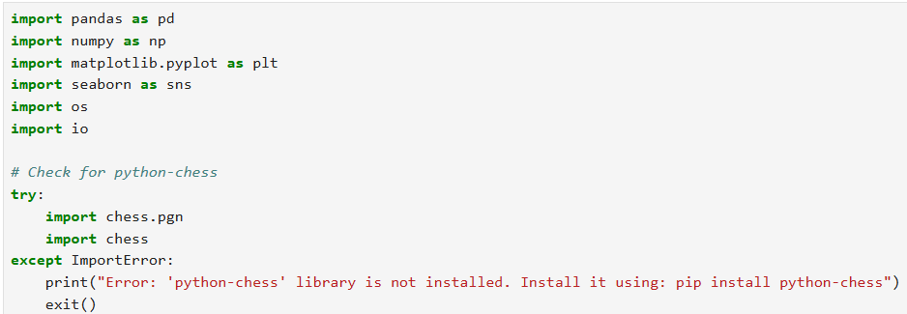
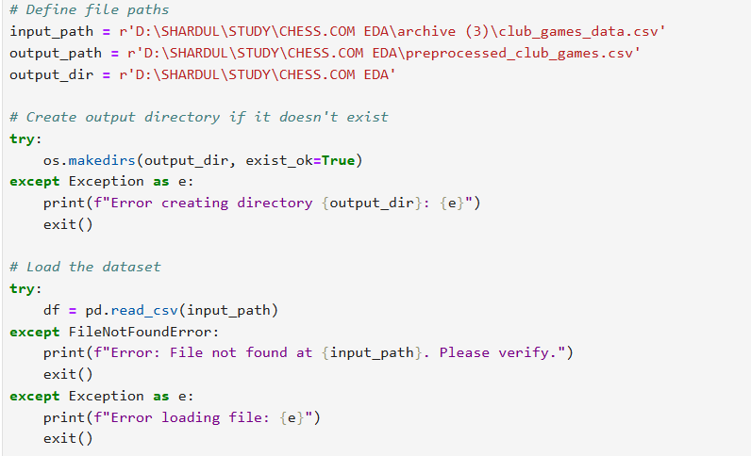
Imported Libraries & Loaded Dataset

Slide 6
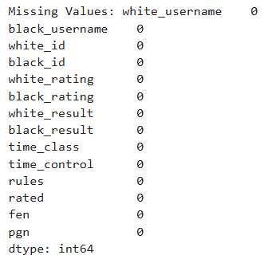
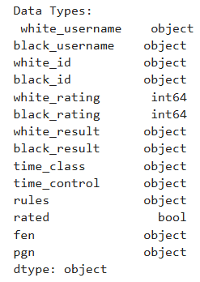
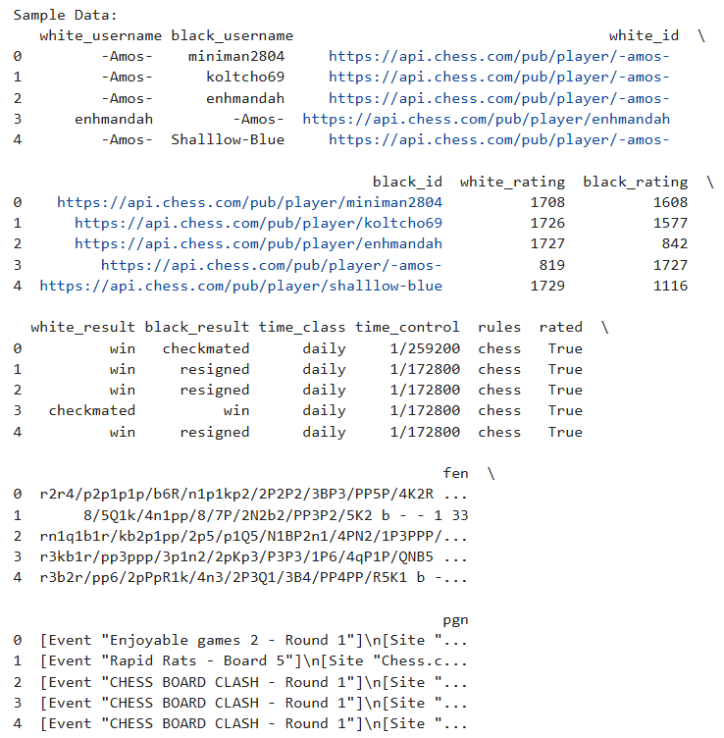
Data Information

Slide 7
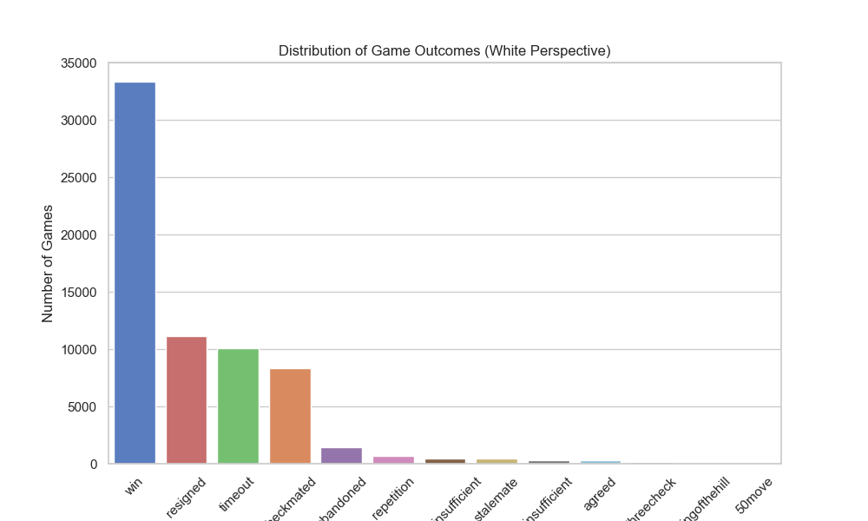
Analysis 1: Game Outcomes (White Perspective)
Analyzed white_result to understand game outcomes for White players.
Key Findings:
The most common outcome is a win for White, with over 30,000 games.
Resigned games follow, with approximately 10,000-12,000 games.
Timeout and checkmated outcomes each have around 8,000-10,000 games.
Abandoned, repetition, insufficient material, stalemate, insufficient moves, agreed, threecheck, kingofthehill, and 50move rule outcomes are significantly less frequent, each below 5,000 games.
Insight: The data indicates that wins dominate, with resignations and timeouts also being notable outcomes.
Figure 1: White Game Outcomes

Slide 8
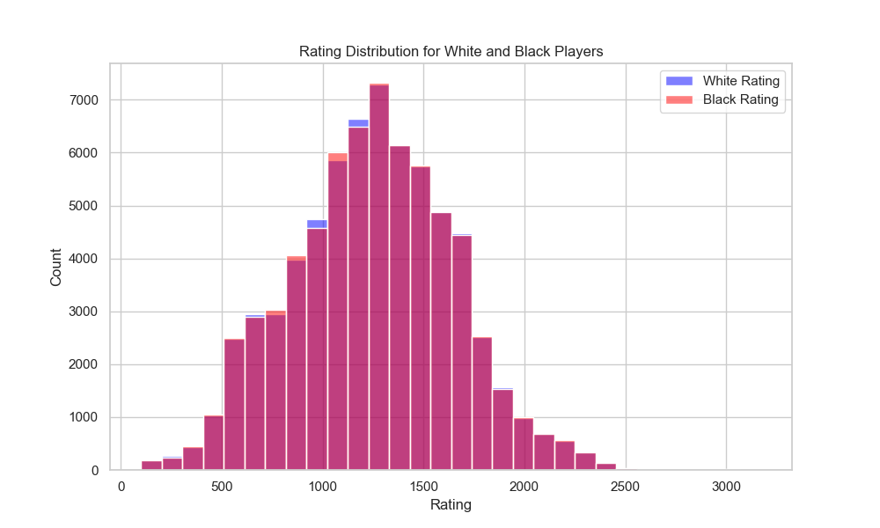
Analysis 2: Rating Distribution
Analyzed Rating distribution for Black & White Players.
Key Findings:
The majority of players have ratings clustered around 1000-1500, with a peak count exceeding 6000-7000.
Both White and Black rating distributions are similar, forming a bell-shaped curve centered around this range.
White ratings (blue) and Black ratings (red) show slight variations, with White having a marginally higher peak around 1000-1500.
The number of players drops significantly beyond 2000, with very few players rated above 2500.
Insight: The data suggests a balanced distribution with most players falling into the intermediate rating range.
Figure 2: Rating Distribution

Slide 9
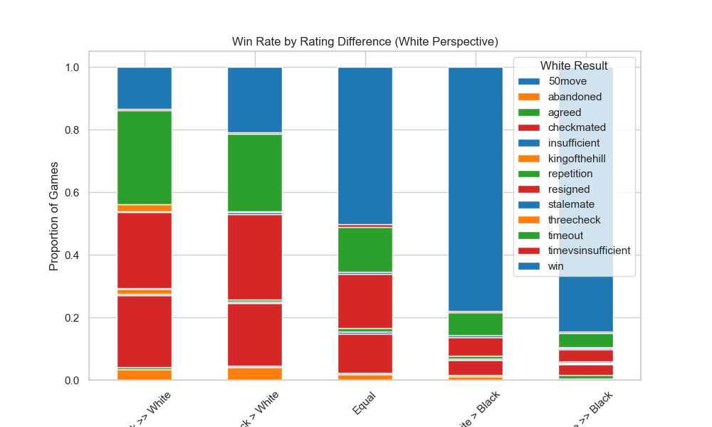
Analysis 3: Win Rate by Rating Difference
Explored white_result across rating_diff_bin.
Key Findings:
When White's rating is much higher (>> White), the win rate is the highest, dominated by "win" (over 0.8 proportion), with minimal other outcomes.
For a moderate White advantage (> White), "resigned" and "win" are significant, each around 0.1-0.7 proportion, with other outcomes like "checkmated" and "agreed" also present.
In equal rating scenarios, win rate is reduced to 0.5 proportion and increasing the chances of checkmate, timeout & resigned.
When Black's rating is higher (> Black), "win" for White drops significantly (Near to 0.2), with "resigned" and "checkmated" increasing, reflecting Black's advantage.
For a much higher Black rating (>> Black), "win" for White is minimal, with "resigned" and "checkmated" dominating, alongside some "timeout" and "insufficient" outcomes.
Insight: The data suggests a strong correlation between rating difference and win rate, with White's success decreasing as Black's rating exceeds White’s.
Figure 3: Win Rate by Rating Difference

Slide 10
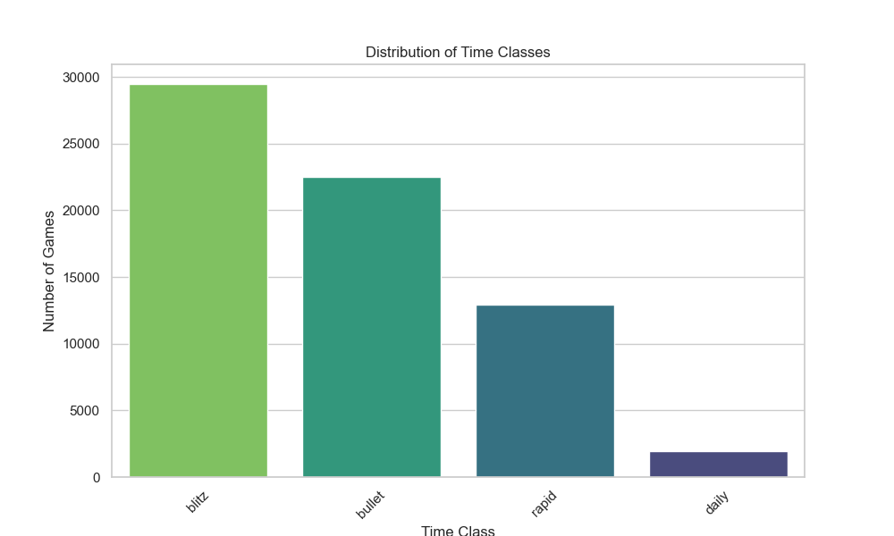
Analysis 4: Game Duration by Time Class
Analyzed number of games across time_class (daily, rapid, blitz, bullet).
Key Findings:
Blitz is the most popular time class, with near to 30,000 games.
Bullet follows with approximately 20,000-25,000 games.
Rapid has around 12,000-15,000 games.
Daily is the least common, with fewer than 5,000 games.
Insight: The data indicates a strong preference for faster-paced games (Blitz and Bullet) over slower formats (Rapid and Daily).
Figure 4: Game Count by Time Class

Slide 11
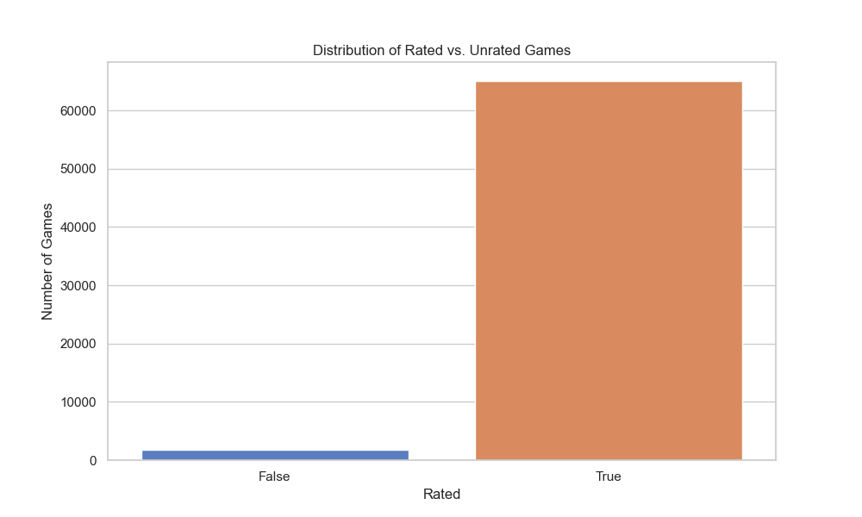
Analysis 5: Rated vs. Unrated Game Outcomes
Compared games between rated games & unrated games.
Key Findings:
The majority of games are rated, with over 60,000 games.
Unrated games are significantly fewer, with a count of approximately 5,000 or less.
This indicates a strong preference for rated games among players.
Figure 5: Rated Vs Unrated Game Counts

Slide 12
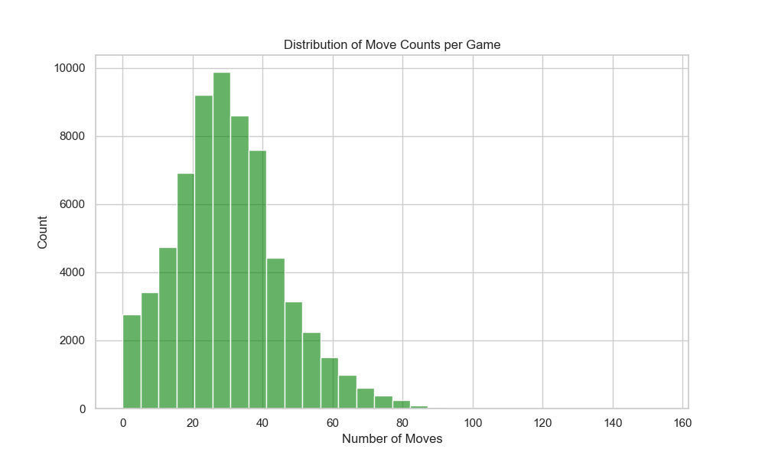
Analysis 6: Move Count Distribution
Examined move_count distribution across games.
Key Findings:
The highest frequency occurs between 20 and 40 moves, peaking at over 10,000 games.
The distribution forms a bell-shaped curve, with the majority of games ranging from 20 to 60 moves.
The count drops significantly beyond 60 moves, with very few games exceeding 100 moves.
Most games are relatively short, with a sharp decline in frequency as the move count increases past 40.
Insight: Most games resolve within 40 moves.
Figure 6: Move Count Distribution

Slide 13
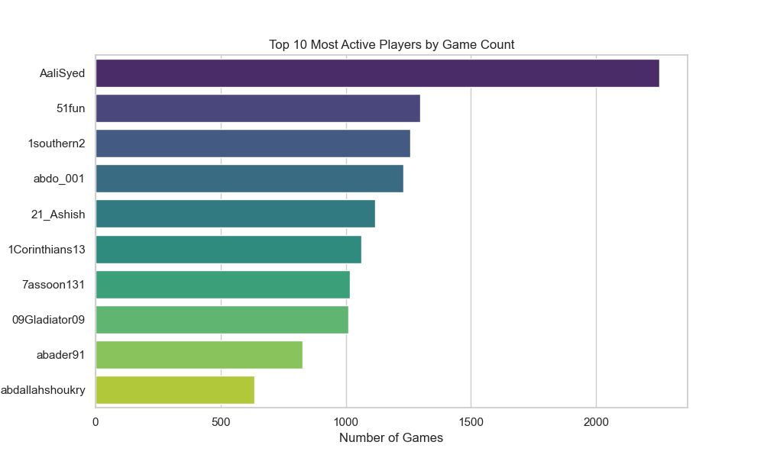
Analysis 7: Top 10 Active Players
Counted total games per player.
Key Findings:
AaliSyed is the most active player, with over 2,000 games.
51fun follows with approximately 1,500-2,000 games.
1southern2, abdo_001, 21_Ashish, 1Corinthians13, Tassoon131, 09Gladiator09, abader91, and abdallahshoukry rank next, each with game counts ranging from about 500 to 1,500.
The data indicates a significant drop-off in game count after the top two players, with AaliSyed showing notably higher activity.
Figure 7: Top 10 Active Players

Slide 14
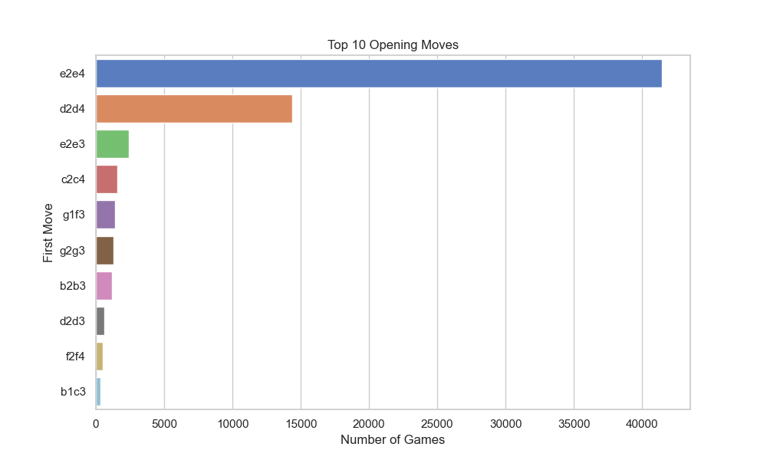
Analysis 8: Top 10 Opening Moves
Analyzed first_move to identify common openings.
Key Findings:
The move e2e4 is the most common, with over 40,000 games.
d2d4 follows as the second most popular, with approximately 15,000 games.
e2e3 ranks third, with around 3,000 games.
Other moves (c2c4, g1f3, g2g3, b2b3, d2d3, f2f4, b1c3) have significantly lower frequencies, each below 3,000 games.
The data highlights a strong preference for e2e4 and d2d4 as dominant opening moves.
Insight: Standard openings prevail in most of the games.
Figure 8: Top 10 Opening Moves

Slide 15
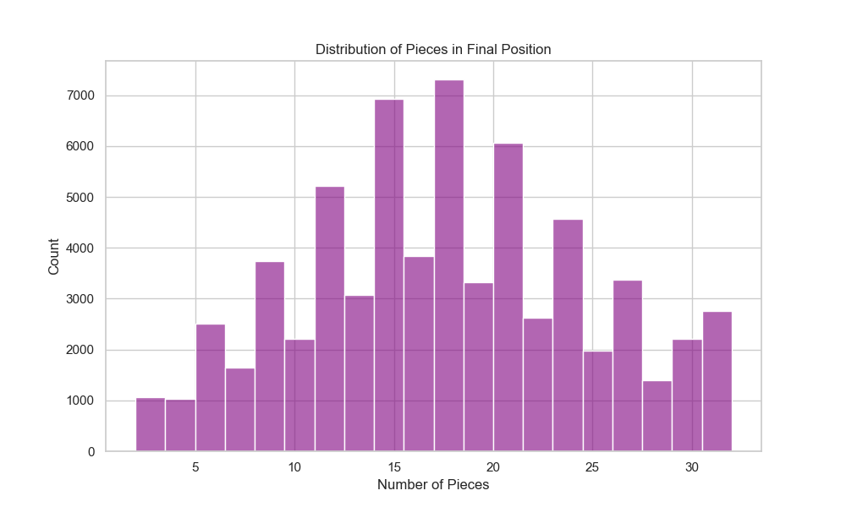
Analysis 9: Piece Count in Final Positions
Examined piece_count from final FEN positions.
Key Findings:
The highest frequency is around 15-20 pieces, with a peak count exceeding 7,000.
The distribution is roughly bell-shaped, indicating that most data points cluster around the center (15-20 pieces).
The count decreases symmetrically on both sides, with lower frequencies at the extremes (e.g., 0-5 and 25-30 pieces).
Insight: Mostly Games end with significant material on board.
Figure 9: Piece Count Distribution in Final Position

Slide 16
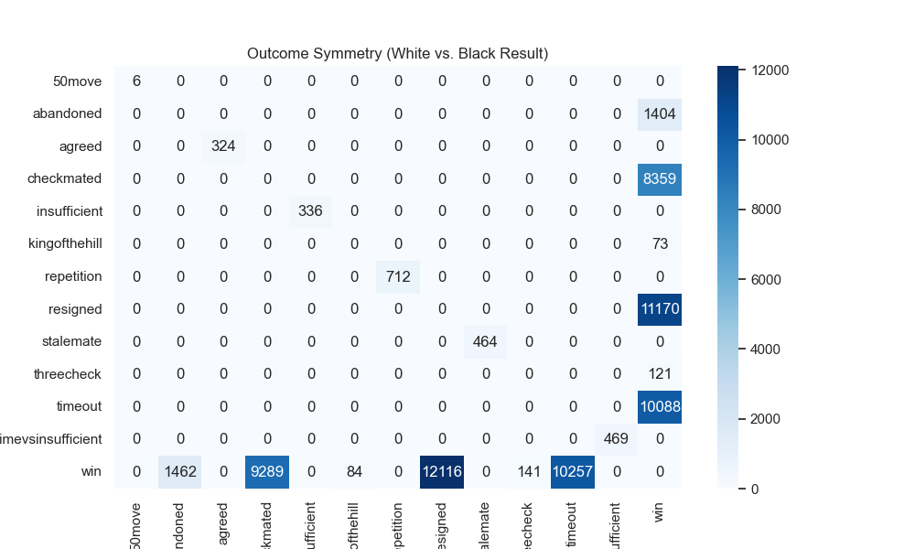
Analysis 10: Outcome Symmetry
Compared white_result vs. black_result.
Key Findings:
The most common outcome is a win, with 33,349 games won by White and 31,215 by Black.
Resignation is frequent, with 11,170 games ending this way for White and 12,116 for Black.
Checkmate occurs in 8,359 games (White) and 9,289 (Black).
Timeout occurs in 10,088 games (White) and 10,257 (Black).
Win with Kingofthehill (W-84/B-73) & threecheck (W-141/B-121) are less common.
Other outcomes which results in draw are very rare like 50moves (6), Agreed (324), Insufficient Material (336), Repetition (712), Stalemate (464), Time insufficient (469).
Insight: The data suggests a slight advantage for White in most outcome categories.
Figure 10: Outcome Symmetry

Slide 17
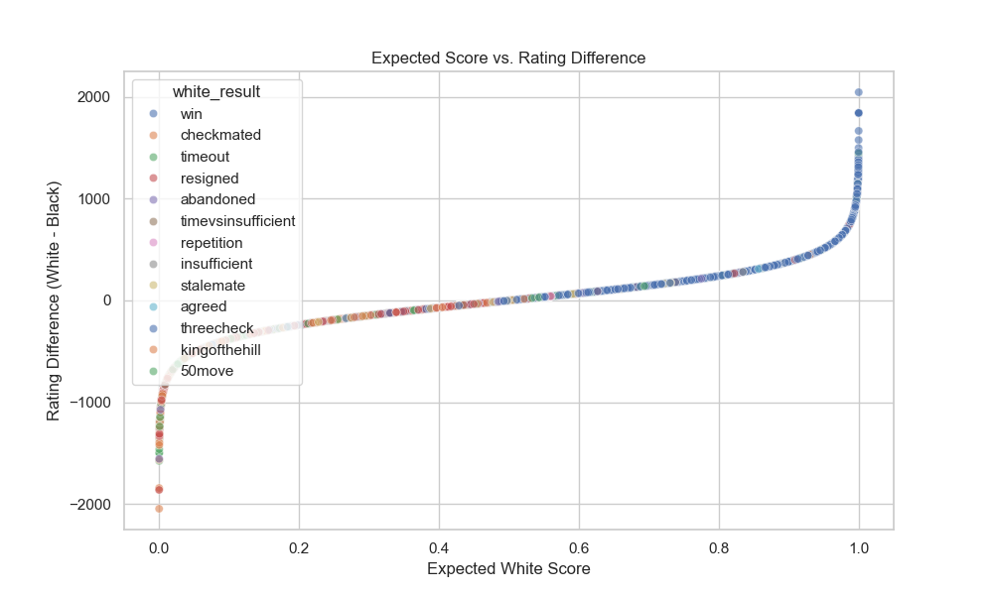
Analysis 11: Rating Change Impact
Relationship between the expected score for White and the rating difference between White and Black.
Key Findings:
As the expected White score increases from 0 to 1, the rating difference (White - Black) rises from approximately -2000 to 2000.
A rating difference near 0 corresponds to an expected White score around 0.5, indicating an even match.
Outcomes like "win" dominate at higher expected scores (above 0.8) with rating differences exceeding 500.
Negative rating differences (e.g., -1000 to -2000) are associated with lower expected scores (below 0.2), where Black outcomes like “Win" dominate.
Insights: The relationship appears to be a smooth, upward-curving trend, suggesting a strong correlation between rating difference and expected outcome.
Figure 11: Expected Score vs. Rating Difference

Slide 18
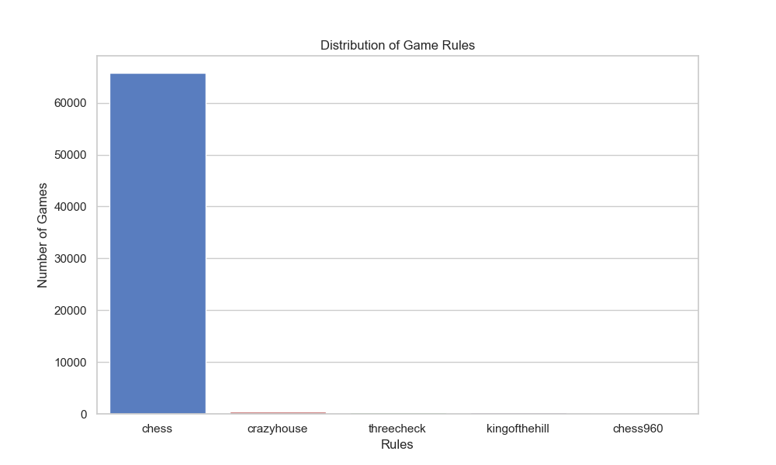
Analysis 12: Distribution of Different Types of Chess Games
The number of games played under different rule sets.
Key Findings:
Standard chess is by far the most popular, with over 60,000 games.
Crazyhouse, threecheck, kingofthehill, and chess960 have significantly fewer games, with counts close to or below 1,000.
Insights: The vast majority of games adhere to standard chess rules, indicating a strong preference for traditional gameplay.
Figure 12: Chess Games Type Distribution

Slide 19
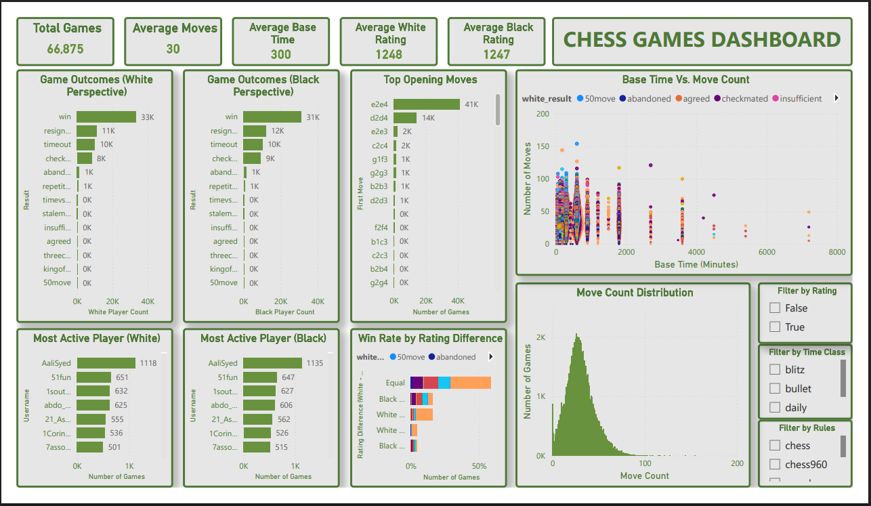
Power BI Dashboard
Visuals:
Platform & Design: Built with Power BI, offering an interactive and user-friendly interface for chess game analysis.
Key Metrics Display: Seamlessly integrates total games, average moves, and player ratings for instant insights.
Visual Elements: Features bar charts, scatter plots, and histograms to visualize outcomes, time vs. move count, and move distribution effectively.
Customization: Includes filters for rating, time class, and rules, enhancing user flexibility.
Strategic Insights: Win rate by rating difference chart showcases trends, making it a powerful tool for enthusiasts and analysts.
Figure 13: Chess Games Dashboard

Slide 20
Technical Skills Demonstrated
Programming: Python (pandas, numpy, seaborn, matplotlib, python-chess).
Data Preprocessing: Handling duplicates, missing values, PGN/FEN parsing.
Visualization: Statistical plots, interactive dashboards.
Power BI: Data modeling, DAX, Power Query, slicers.
Problem-Solving: Resolved errors (e.g., io, chess, DAX).

Slide 21

Thank you for reviewing my project!

